Slide 1



2022 INALA Awards
Sponsored by In Touch Pharmaceuticals

Slide 2
2022 INALA Awards
Sponsored by:
In Touch
Pharmaceuticals

Slide 3
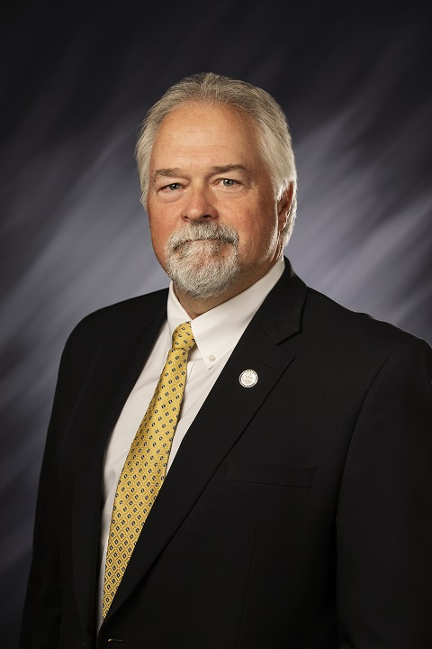
Legislator Of The Year
Dr. Brad Barrett
“We are all fortunate to have Dr. Brad Barrett advocating for our industry at the state capitol building.”
“We have a genuine advocate for our industry in Dr. Barrett.”

Slide 4
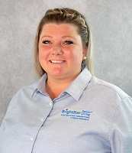
Outstanding Activity Director
Leslie Sibert
“Leslie started her journey with health care in 1994 as a C.N.A. and has given her servant heart to her residents and their families ever since.”
“Leslie sure does make BrightStar Senior Living feel like home for our residents.”

Slide 5
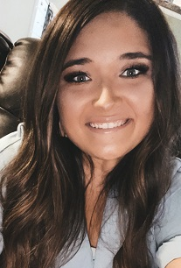
Leader Under 40
Jessie Hawkins
“Her dedication to us is amazing”
“Every employee, including managers has asked for her assistance in one way or another.”

Slide 6
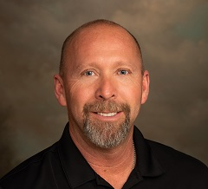
Caregiver of the Year
Ron Cupp
“Ron is always finding ways to make the residents forget they live in an assisted living community.”
“100 residents and 75 employees and he could tell you every single person’s name along the way. A true caregiver through and through.”

Slide 7
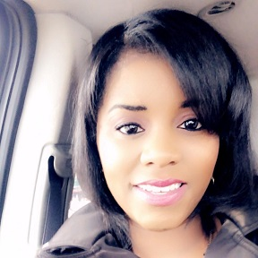
Outstanding Community Director
Deejra Lee
“I want to have a team that is so well connected and educated that when you see us walk into a room, you don’t know who the leader is.”
“Her biggest passion is making sure everyone is living their best life and helping them along the way…”

Slide 8
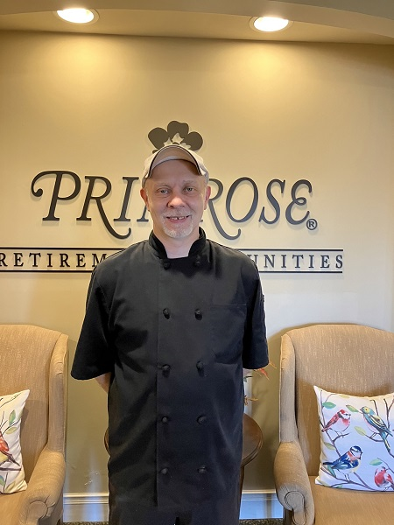
Outstanding Food Service Director
Chef Robert “Bobby” Atkinson
“Our Primrose residents for 13 years have been the beneficiaries of Bobby’s demonstrated knowledge of not only food…but also of the dietary issues necessary for residents’ health.”
“He is always seeking to improve the experience for the residents.”

Slide 9
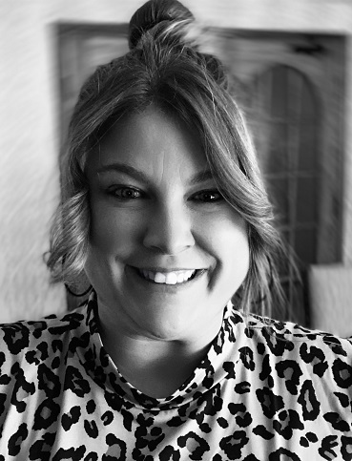
Outstanding Marketing Director
Jennifer Knowles
“Jen will go above and beyond to make new prospects feel right at home and comfortable.”
“She is a beam of light and a joy to have in our community!”

Slide 10
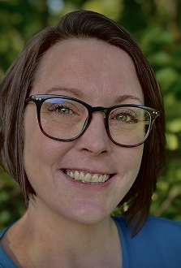
Outstanding Nurse Leader
Alisha Adkison
“The residents here adore Alisha, not only for her kind personality, but she ensures that they are receiving the care they deserve.”
“She greets everyone with a smile.”

Slide 11
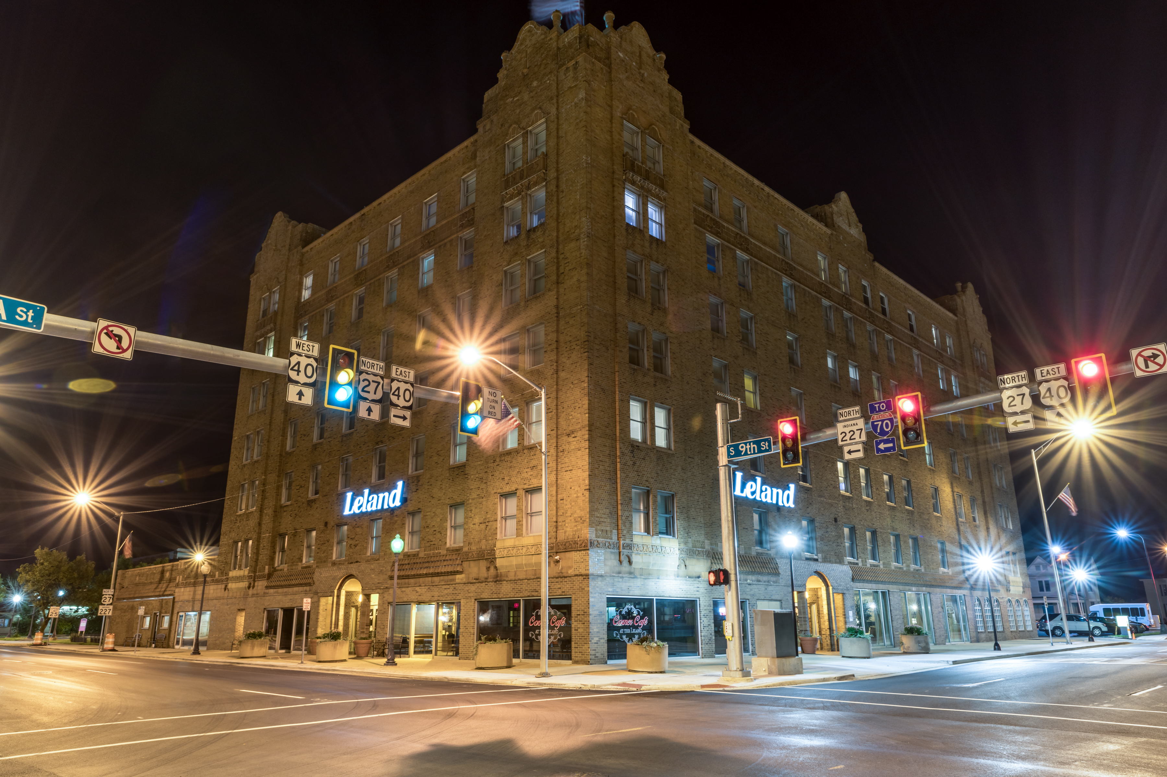

The Assisted Living Community of the Year
The Leland Legacy
“I know I am one of many here, but I was made to feel like the only one.” (Former Resident at the Leland Legacy)

Slide 12
The End
Thank you for attending INALA Fall Conference and INALA Awards 2022.
Congratulations to all Award Winners!

